Slide 1
Project Schedule
Prof. Dr. Dirk Riehle
Friedrich-Alexander University Erlangen-Nürnberg
ARCH-PROJ A02
Licensed under CC BY 4.0 International
Notes:
It is Friedrich-Alexander University Erlangen-Nürnberg – FAU, in short.
Corporate identity wants us to say “Friedrich-Alexander University”.

Slide 2
Project Schedule
# | Project Deliverables
01 | -
02 | Project documents
03 | Project plan of attack
04 | -
05 | -
06 | Architecture documentation
07 | -
08 | -
09 | Analysis and evaluation
10 | -
11 | -
12 | Suggestions for improvement
13 | Final report
14 | Presentation
15 | -

Slide 3
Weekly Rhythm
Lecture
  Thursdays 10:15-11:45 Uhr, 12:30-13-55 Uhr
Team meeting
  On demand with coaches
Project work
  Self-organized

Slide 4
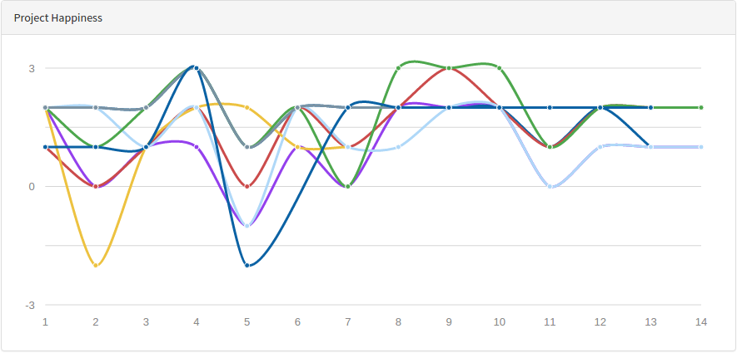
Happiness Index
Provide weekly feedback about team and project
  https://uni1-happy.appspot.com

Slide 5
Deliverables Time
Midnight before the day of class
  We will provide feedback during the next day’s team meeting, if any
First week differs
  Deliverables of first week are due by Friday midnight that week

Slide 6
Deliverables Format
Project reports
  Always as PDF
  Also in source format; acceptable source formats are
    Libre/OpenOffice or Microsoft Office
      DOC or ODT
      PPT or ODP
Source materials
  Depends on project
  In native format of tool

Slide 7
Deliverables Process
By upload to course management system (documents)
By email to teaching team (if no upload section exists)

Slide 8
CW #01 Deliverables
Happiness Index

Slide 9
CW #02 Deliverables
Team contract, as PDF-Scan, by email
  More information at https://wp.me/PDU66-1su
Contributor agreement, as PDF-Scan, by email
  More information at https://wp.me/PDU66-Gk
  Also provide in paper to university coach
Happiness index

Slide 10
CW #03 Deliverables
Plan of attack, as PDF, by email
  Explanation of how you intend to approach the project including
    Expected challenges and how to address them
    Who does what by when?
  The purpose is to give you feedback
Happiness index

Slide 11
CW #04 Deliverables
Happiness index

Slide 12
CW #05 Deliverables
Happiness index

Slide 13
CW #06 Deliverables
Draft of report, as PDF, by email, including
  Architecture documentation
    Use arc42 template, remove irrelevant sections
Happiness index

Slide 14
CW #07 Deliverables
Happiness index

Slide 15
CW #08 Deliverables
Happiness index

Slide 16
CW #09 Deliverables
Draft of report, as PDF, by email, including
  Revised architecture documentation
  Analysis and evaluation
    Add necessary sections to document
Happiness index

Slide 17
CW #10 Deliverables
Happiness index

Slide 18
CW #11 Deliverables
Happiness index

Slide 19
CW #12 Deliverables
Draft of report, as PDF, by email, including
  Revised architecture documentation
  Revised analysis and evaluation
  Suggestions for improvement
    Add necessary section(s) to document
Happiness index

Slide 20
CW #13 Deliverables
Final report, as PDF and DOC / ODT, by email, including
  Architecture documentation
  Analysis and evaluation
  Suggestions for improvement

Slide 21
CW #14 Deliverables
Final presentation, as PDF and PPT / ODP, by email
All source materials

Slide 22
CW #15 Deliverables
None

Slide 23
Thank you! Questions?
dirk.riehle@fau.de – http://osr.cs.fau.de
dirk@riehle.org – http://dirkriehle.com – @dirkriehle
DR

Slide 24
Credits and License
Original version
  © 2012-2020 Dirk Riehle, some rights reserved
  Licensed under Creative Commons Attribution 4.0 International License
Contributions
  None yet

